Slide 1
GOOGLE TAG MANAGER

Slide 2
INTRODUCTION
Google Tag Manager (GTM) is a free solution, introduced in October 2012.
GTM is for managing Google Analytics, advertising and other tracking tags across your website or multiple websites.

Slide 3
What is Google Tag Manager?
According to Google:
“Google Tag Manager allows you to conveniently manage tags (such as tracking and marketing optimization tags) on your site. You can add and update AdWords, Google Analytics and non-Google tags from the Google Tag Manager user interface instead of editing site code. This reduces errors, frees you from having to involve a webmaster, and allows you to quickly deploy tags on your site. ”

Slide 4
Tags are tiny bits of website code that send information to third party to measure you measure traffic ,visitor behavior etc.
If you don't use a tag management solution such as Tag Manager, you need to add these snippets of code directly to files on your website or mobile app.
With Tag Manager, you no longer need to maintain each of these code snippets in your source files
You specify the tags that you want to fire, and when you want them to fire, from within the Tag Manager user interface.

Slide 5
How Google Tags Works ?
Tag Manager for web works via its own container tag that you place on all your website pages
You place a small snippet of code on your website or mobile app. This code connects your app to the Tag Manager servers.
Once the Tag Manager container tag has been added to your site or app, you update, add, and administer additional tags right from the Tag Manager web application.
You can configure triggers to fire when an event occurs. An event could be a page load, a form submission, or a tap on a screen. When the trigger fires the tag, the tag's code executes.
Google Tag Manager executes asynchronously and can be configured to fire tags only when they are needed, helping your pages to load more quickly

Slide 6
Benefits with GTM :-
To Manage tags outside of development work.
GTM can be used in both Mobile sites and Normal sites.
Decrease page load time by firing tags in GTM.
GTM makes tag management very efficient
It is free.

Slide 7
Main Parts of Google Tag Manager
Tags – Tell GTM what you want it to do. For example, “Send a page view to Google Analytics.”
Triggers – Tell GTM when you want it to fire a tag. For example, “Anytime someone visits a page.”
Variable-In Google Tag Manager, the term Variable is used to denote a helper function that your Tags, Triggers, and other Variables can invoke to retrieve values from. Invoking syntax .{{variablename}}

Slide 8
Initial Setup
Just visit the Google Tag Manger page and sign in. Follow the steps to create your first account and you’ll be asked to set up something called a “container”.
Typically, you’ll create a container for each website you’ll want to track.

Slide 9
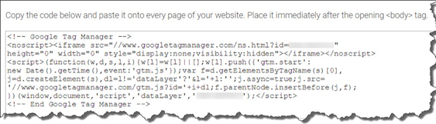
Initial Setup
Once you’ve created your account, and your first container, GTM will give you a snippet of code that looks like this:
Once you’ve created your account, GTM will give you a snippet of code that looks like this:
Just copy and paste this code so it’s right after the opening <body> tag of your site .

Slide 10
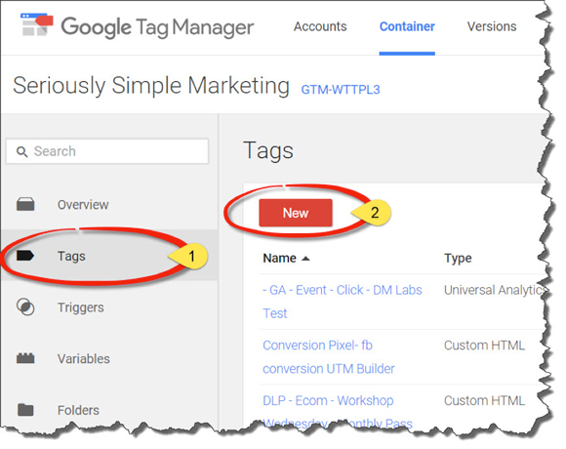
Usage with Google Analytics.
Step #1: Create a New Tag
Create a new tag by clicking on “Tags” on the left menu and then “New”.

Slide 11
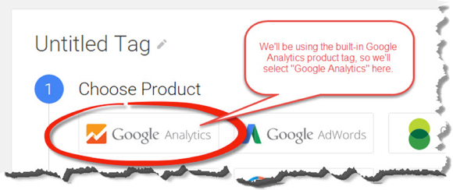
Google Tag Manager will then want to know which type of product you would like to create a tag for. Fortunately, Google Analytics is deeply integrated with GTM.
We’ll take advantage of this integration by selecting “Google Analytics.”

Slide 12
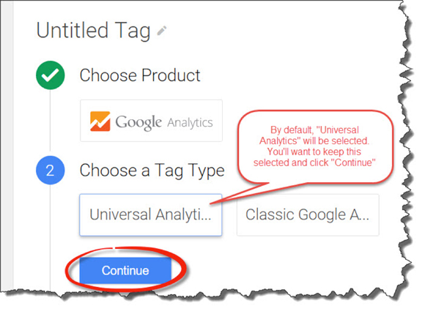
Choose Your Analytics
From there, GTM will ask you if you want to use Universal or Classic Analytics. You’ll want to use Universal Analytics. It’s selected by default and is the newest version of GA.

Slide 13
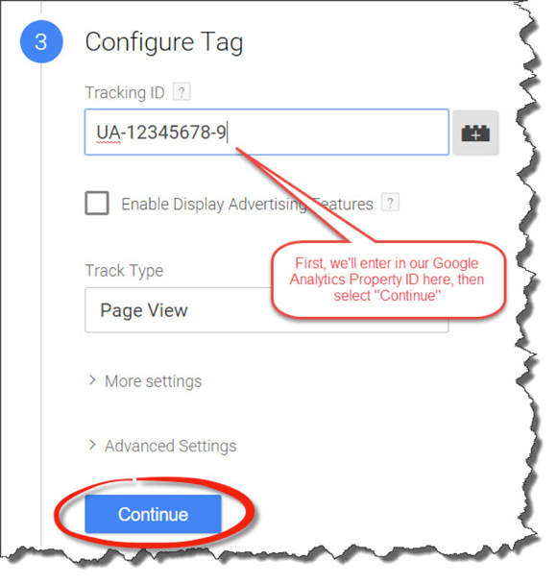
Configure Your Tag
In this case, we’ll need to type in our Property ID.
“UA-12345678-9” as an example here.

Slide 14
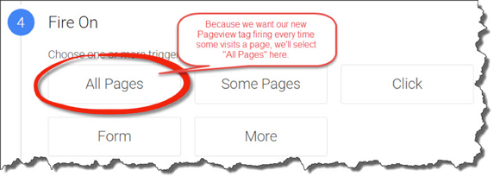
Define Your Trigger
After clicking “Continue”, we’ll need to define the Trigger..In this case, we want it to report Page views whenever someone visits a page, so we’ll select “All Pages” from the list of built-in Triggers listed.

Slide 15
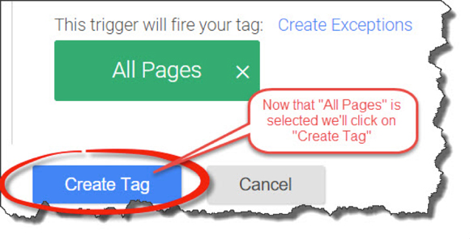
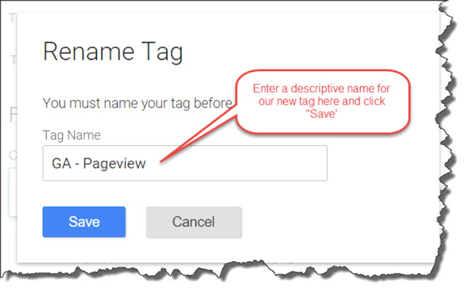
Create & Name Your Tag
Once we’ve selected “All Pages”, we’ll click “Create Tag”.
Google Tag Manager will ask us for a name for our new Tag. We’ll call it “GA – Page view”.

Slide 16
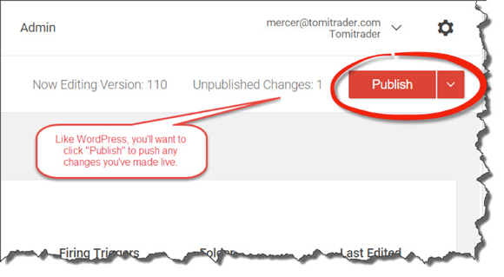
Publish Your Tag
You’ll need to “Publish” your changes before they become live
In the upper right corner of your page, you’ll see how many changes are currently waiting to be published and the “Publish” button.

Slide 17
Publish Your Tag
Once you click “Publish” your changes are live and your newly created Page view tag is officially passing data to Google Analytics!
And there you have it. Your first tag, telling GTM to send a Page view to Google Analytics and your first trigger, telling GTM to send that Page view every time a page is loaded.

Slide 18
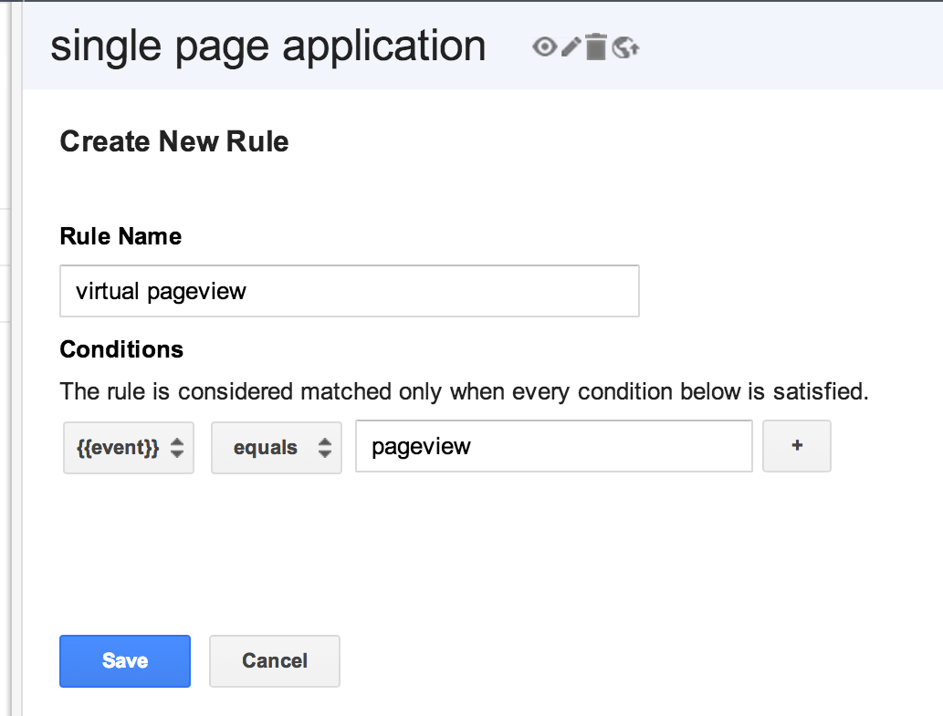
Google Tag Manager && Analytics
Google Tag manager for a Single Page Application.
In your Google Tag Manager container, add a new rule called ‘virtual pageview’ and set the event macro {{event}} equals ‘pageview’.
Click Save.

Slide 19
Google Tag Manager && Analytics
In your Google Tag Manager container, add a new rule called ‘virtual pageview’ and set the event macro {{event}} equals ‘pageview’
. Now we’ll create a new Google Tag Manager macro that watches for a virtual url to appear in the data layer.
Data layer
A data layer is an JavaScript object that contains all of the data that you want to pass to Google Tag Manager from your web page. This data can be about the page itself, events on the page or about user interacting with the page.

Slide 20
Google Tag Manager && Analytics
Enter a descriptive name for the macro such as ‘virtual url’
Set the Macro Type to ‘Data Layer Variable’
Set the Data Layer Variable Name to ‘virtualUrl’ (Note: this is the variable name you’ll need to specify in the Data Layer for the URL you want to track in Google Analytics)
Click Save.

Slide 21
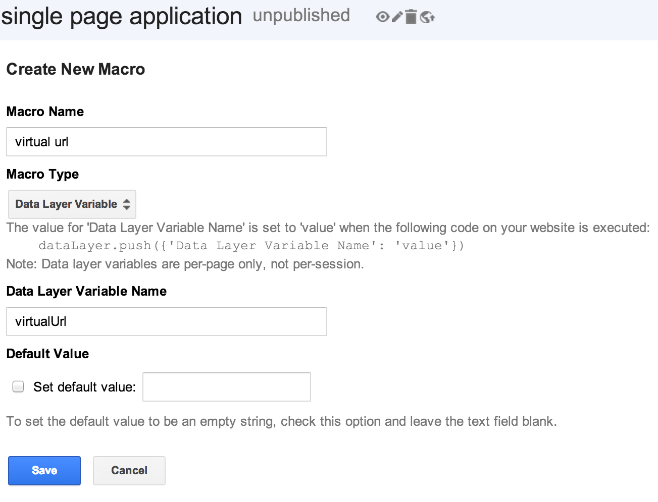
Google Tag Manager && Analytics

Slide 22
Google Tag Manager && Analytics
It’s time to create our Google Analytics tag to fire when a new virtual pageview occurs.
Enter a descriptive name for the Tag
Choose a Tag Type of ‘Google Analytics’
Enter your GA Profile ID
Set the Track Type to ‘Page View’
Expand Basic Configuration
Check the Virtual Page Path box
Click the +{{macro}} button
Select the virtual url macro you created earlier
Add a firing rule for the tag and choose the ‘virtual pageview’ rule created earlier
Click Save

Slide 23
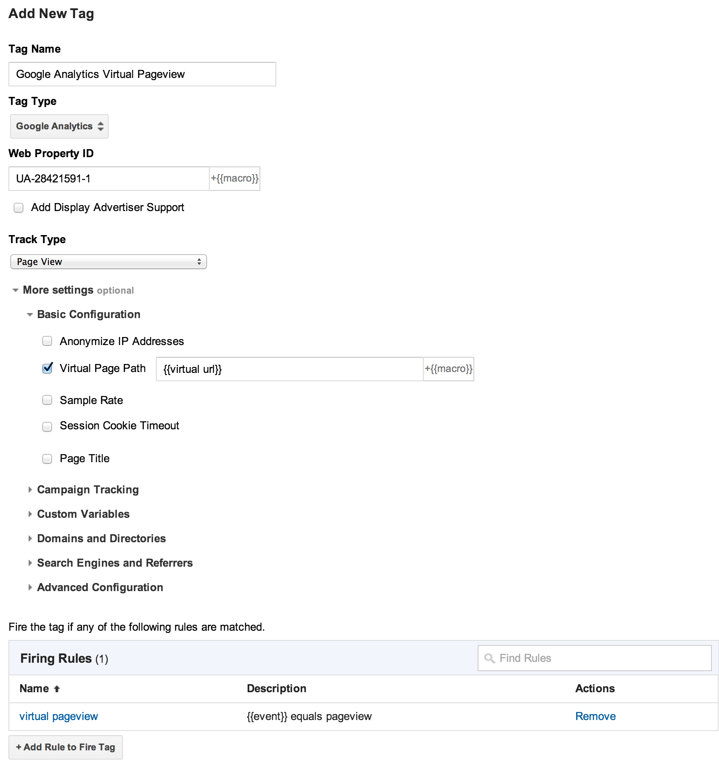

Slide 24
Google Tag Manager && Analytics
Now it’s time to populate the data layer with a virtual url when a user changes the view on our single page application. This might look something like:
<html><head>
<script>
dataLayer = [];
</script><script>
function loadProductDetails(productIdentifier) {
dataLayer.push({
'event':'pageview',
'virtualUrl':'/product/'+productIdentifier
});}</script>

Slide 25
</head><body>
<!-- Google Tag Manager -->
<noscript><iframe src="//www.googletagmanager.com/ns.html?id=GTM-3VLTP"
height="0" width="0" style="display:none;visibility:hidden"></iframe></noscript>
<script>(function(w,d,s,l,i){w[l]=w[l]||[];w[l].push({'gtm.start':
new Date().getTime(),event:'gtm.js'});var f=d.getElementsByTagName(s)[0],
j=d.createElement(s),dl=l!='dataLayer'?'&l='+l:'';j.async=true;j.src=
'//www.googletagmanager.com/gtm.js?id='+i+dl;f.parentNode.insertBefore(j,f);
})(window,document,'script','dataLayer','GTM-3VLTP');</script>
<!-- End Google Tag Manager -->
...
<a onclick="loadProductDetails('nexus7');">Nexus 7</a>
...
</body>
</html>

Slide 26
Google Tag Manager && Analytics
Now when a user clicks to view the the product details for a Nexus 7, the loadProductDetails function fires and pushes a new item into the data layer. Google Tag Manager is watching the data layer and fires the ‘virtual pageview’ rule which triggers the Google Analytics Virtual Pageview tag passing in a virtual URL of ‘/product/nexus7′. (‘nexus7′ is the productIdentifer parameter passed into the loadProductDetails function.)
Verify it’s working by viewing the Real-time Analytics reports for your GA profile. You should see the ‘/product/nexus7′ pageview listed under the ‘Top Active Pages’.

